Slide 1
ITEC100 – Preparation for Domain 5 Post-Assessment
Tutor: Dr. Farshid Keivanian

Slide 2
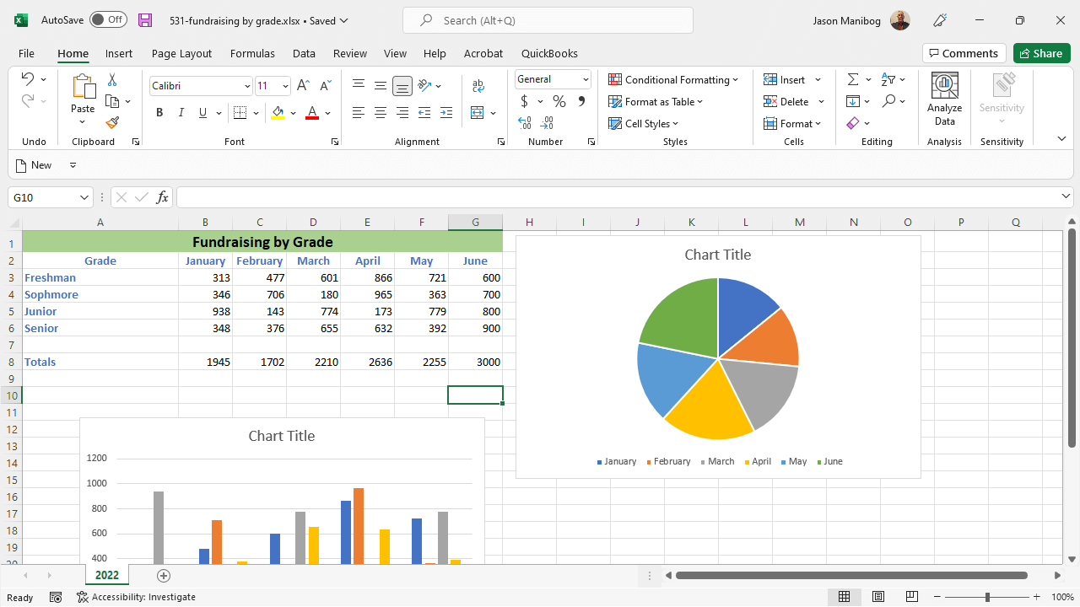
Change the pie chart on the current worksheet to a 3-D pie chart, apply Layout 4 to the chart, and then change the Y rotation on the chart to 50 degrees.
1. Select the Pie Chart:
Click on the existing pie chart in your worksheet to select it.
2. Change the Chart Type:
With the chart selected, go to the Chart Tools on the Ribbon.
Click on the Design tab.
In the Type group, click on Change Chart Type.
Choose 3-D Pie from the list of available chart types and click OK.

Slide 3
Change the pie chart on the current worksheet to a 3-D pie chart, apply Layout 4 to the chart, and then change the Y rotation on the chart to 50 degrees.
3. Apply Layout 4:
With the chart still selected, go to the Chart Tools on the Ribbon.
Click on the Design tab.
In the Chart Layouts group, click on Quick Layout.
Select Layout 4 from the dropdown options.
4. Change the Y Rotation:
Right-click on the 3-D pie chart and select 3-D Rotation from the context menu.
In the Format Chart Area pane that opens, under 3-D Rotation, find the Y Rotation setting.
Change the Y Rotation to 50 degrees.
Click Close or press Enter to apply the change.

Slide 4
Change the pie chart on the current worksheet to a 3-D pie chart, apply Layout 4 to the chart, and then change the Y rotation on the chart to 50 degrees.
By following these steps, you will successfully modify the pie chart according to the instructions provided.

Slide 5
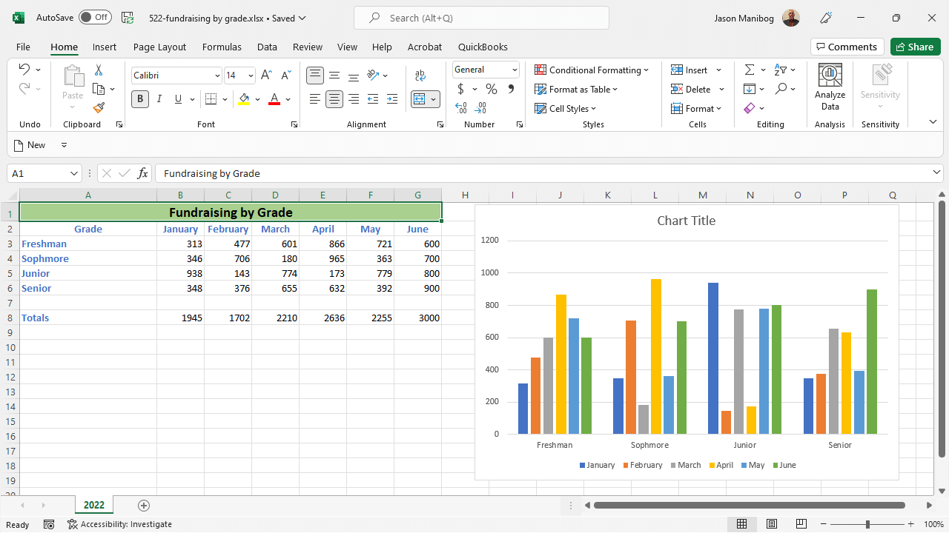
Change the column chart on the current worksheet to show the data by grade instead of by month. Then, add a Linear trendline to this chart for the Senior series and change the gridlines to the Primary Minor Horizontal setting.
1. Select the Column Chart:
Click on the existing column chart in your worksheet to select it.

Slide 6
Change the column chart on the current worksheet to show the data by grade instead of by month. Then, add a Linear trendline to this chart for the Senior series and change the gridlines to the Primary Minor Horizontal setting.
2. Change the Data Series to Show by Grade:
Right-click on the chart and select Select Data.
In the Select Data Source dialog box, you will see two lists: Legend Entries (Series) and Horizontal (Category) Axis Labels.
Click Switch Row/Column to change the data orientation from by month to by grade.
Review the changes to ensure that the grades are now on the X-axis, and the data series represent each month.

Slide 7
Change the column chart on the current worksheet to show the data by grade instead of by month. Then, add a Linear trendline to this chart for the Senior series and change the gridlines to the Primary Minor Horizontal setting.
3. Add a Linear Trendline to the Senior Series:
Click on the Senior series in the chart to select it.
Right-click on the Senior series and select Add Trendline.
In the Format Trendline pane, choose Linear as the trendline option.
Close the pane once the trendline is added.

Slide 8
Change the column chart on the current worksheet to show the data by grade instead of by month. Then, add a Linear trendline to this chart for the Senior series and change the gridlines to the Primary Minor Horizontal setting.
4. Change the Gridlines to Primary Minor Horizontal:
Click on the chart to activate the Chart Tools on the Ribbon.
Go to the Chart Elements button (the plus sign icon next to the chart).
Check the Gridlines box, and then click on the arrow next to it to expand the options.
Select Primary Minor Horizontal from the list of gridline options.
By following these steps, you will successfully modify the column chart according to the instructions provided.

Slide 9
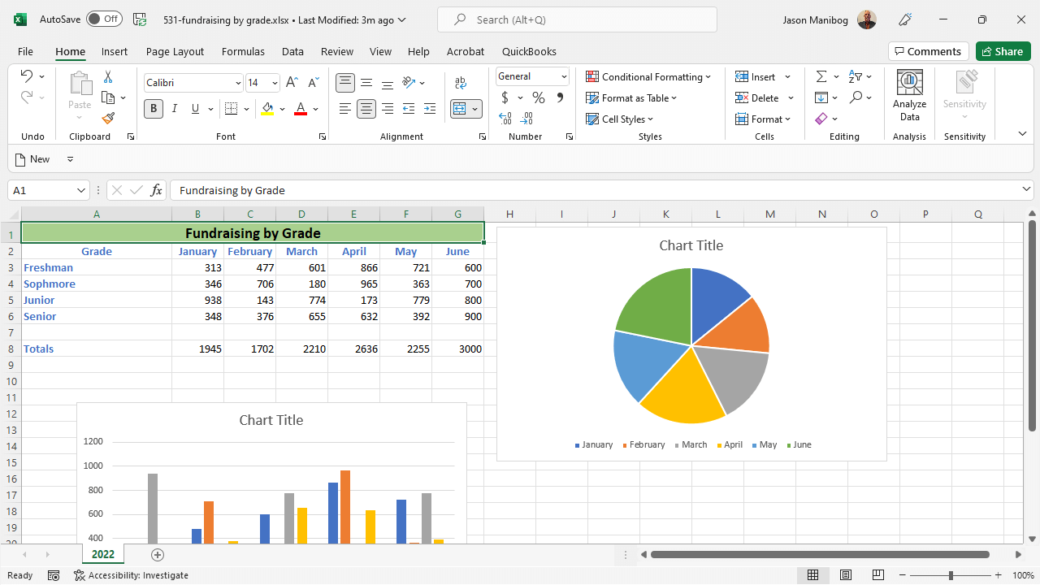
Apply the Style 2 style to the selected chart. Then, add the following alternative text to the chart: Pie chart showing money raised by month. Close the Alt Text pane when complete.
1. Apply Style 2 to the Selected Chart:
Click on the chart to select it.
Go to the Chart Tools on the Ribbon and click on the Design tab.
In the Chart Styles group, look for Style 2 (typically the second style in the list).
Click on Style 2 to apply it to the selected chart.

Slide 10
Apply the Style 2 style to the selected chart. Then, add the following alternative text to the chart: Pie chart showing money raised by month. Close the Alt Text pane when complete.
2. Add Alternative Text to the Chart:
Right-click on the chart and select Edit Alt Text from the context menu.
In the Alt Text pane that appears, type the following text: "Pie chart showing money raised by month."
Close the Alt Text pane after entering the text by clicking the X in the upper-right corner.

Slide 11
Apply the Style 2 style to the selected chart. Then, add the following alternative text to the chart: Pie chart showing money raised by month. Close the Alt Text pane when complete.
By following these steps, you will successfully apply Style 2 to the chart and add the specified alternative text.

Slide 12
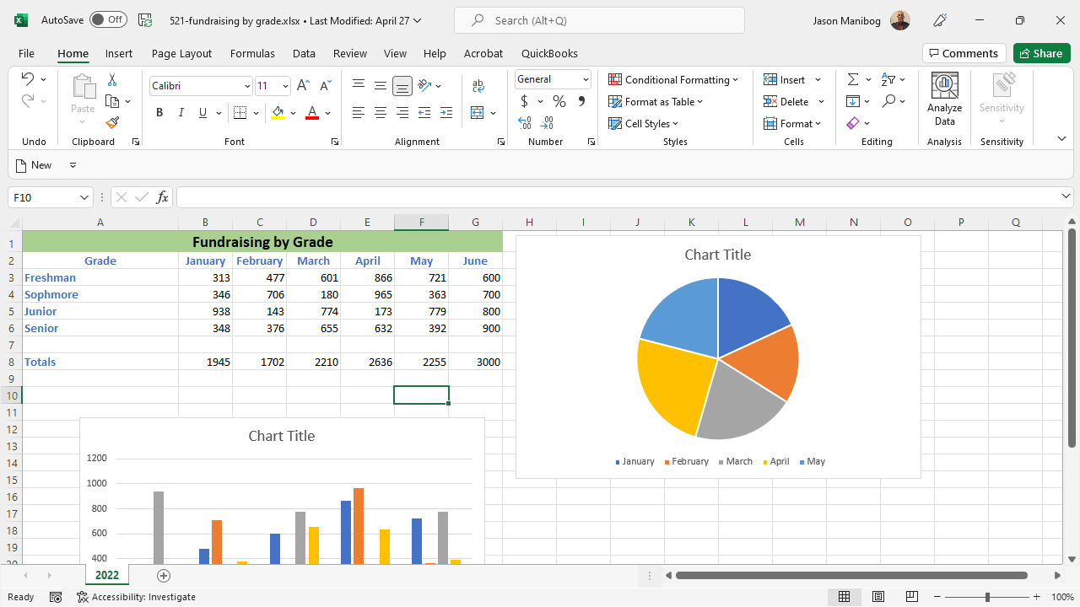
Add the June series to the pie chart on the current worksheet.
1. Select the Pie Chart:
Click on the pie chart in your worksheet to select it.
2. Add the June Series to the Chart:
Right-click on the pie chart and select Select Data from the context menu.
In the Select Data Source dialog box, click on Add to add a new series.
For the Series name, select the June header from your data range (cell G1).
For the Series values, select the data range that corresponds to June (cells G2).
Click OK to add the June series to the pie chart.
Click OK again to close the Select Data Source dialog box.

Slide 13
Add the June series to the pie chart on the current worksheet.
3. Adjust the Chart if Necessary:
If the chart needs adjusting (e.g., if labels or slices overlap), you can format the chart as needed by right-clicking on the chart and selecting Format Data Series.
By following these steps, the June data series will be added to the existing pie chart, reflecting the additional data for the month of June.

Slide 14
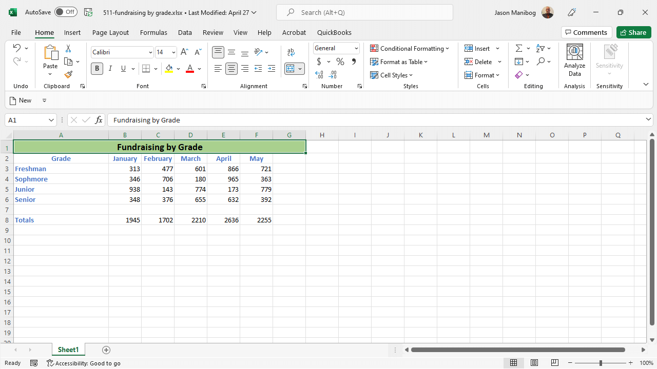
Create a pie chart using the data and heading in the Totals row. Then, move the pie chart to its own sheet, naming the new sheet, Totals by Month.
1. Create a Pie Chart Using the Totals Row:
Highlight the data in the Totals row, including the heading (in this case, cells B7 to G7).
Go to the Insert tab on the Ribbon.
In the Charts group, click on the Pie Chart icon.
Select the desired pie chart type (e.g., 2-D Pie).

Slide 15
Create a pie chart using the data and heading in the Totals row. Then, move the pie chart to its own sheet, naming the new sheet, Totals by Month.
2. Move the Pie Chart to Its Own Sheet:
Right-click on the newly created pie chart.
Select Move Chart from the context menu.
In the Move Chart dialog box, select the New sheet option.
Enter the name "Totals by Month" in the text box.
Click OK to move the chart to a new sheet.

Slide 16
Create a pie chart using the data and heading in the Totals row. Then, move the pie chart to its own sheet, naming the new sheet, Totals by Month.
By following these steps, you will successfully create a pie chart based on the Totals row data and move it to a new sheet named "Totals by Month."

Slide 17

Happy A Learning Day
Thank you
Dr. Farshid Keivanian

